Slide 1
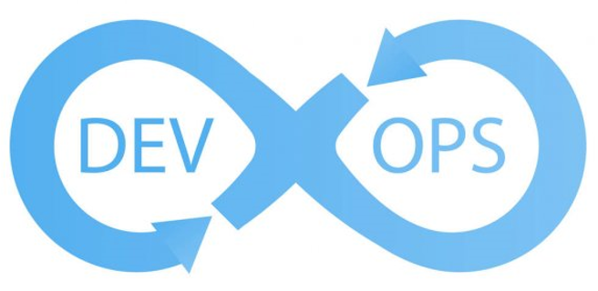
Final Project: Simple CI/CD presentation
SNIEOSIKOV OLEH
Epam - DevOps_online_Dnipro_2020Q42021Q1

Slide 2















Technologies used

Slide 3
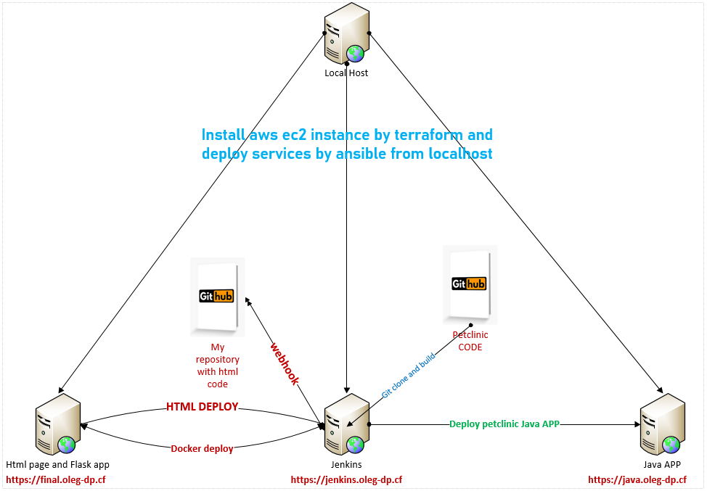
Infrastructure scheme

Slide 4
Purpose of my project is to create my infrastructure just a click
Implementation plan
Configure A records of DNS server to my fqdn sites: final.oleg-dp.cf, jenkins.oleg-dp.cf, java.oleg-dp.cf
Allocate 3 Elastic IP address for each instance
Installing terraform and ansible on local Ubuntu Linux machine
Writing code for building infrastructure in Terraform on Aws (For example, some software will be installed by terraform)
Prepare needed configuration in Ansible for Jenkins
Prepare needed configuration in Ansible for Front End instances
Auto deploy infrastructure with SSL Lets`Encrypt Certificates on each site
Logon to Jenkins and check jobs
Run Job for Java APP deploy
Looking at the Front End and check it working capacity

Slide 5
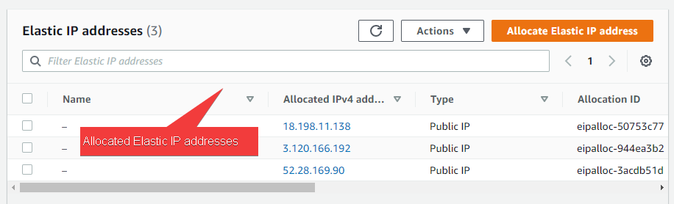
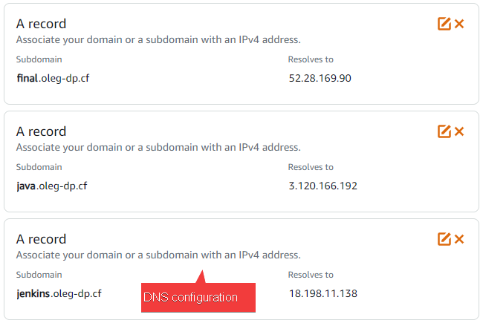

Slide 6
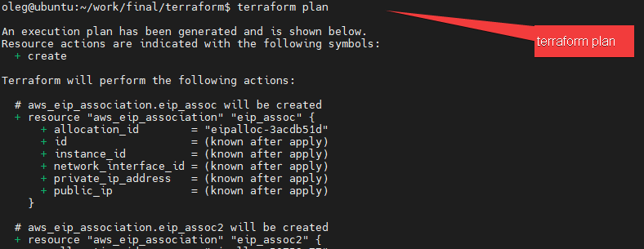
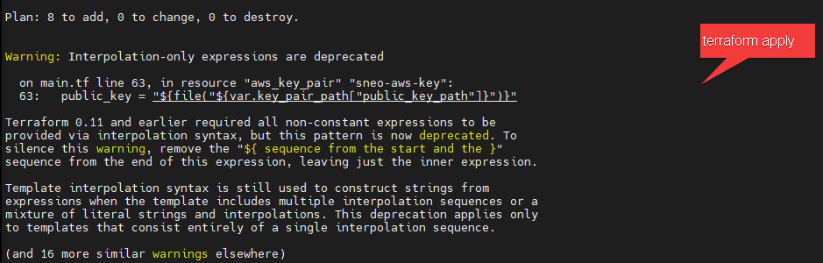
Progress of deployment

Slide 7
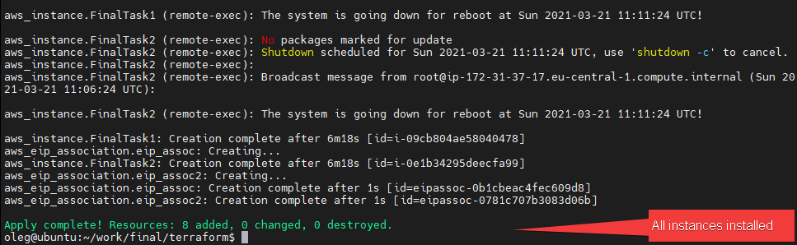
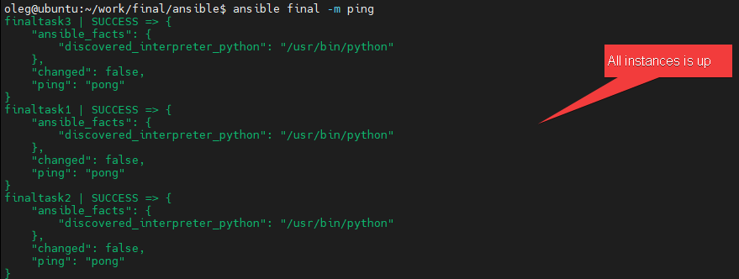

Slide 8
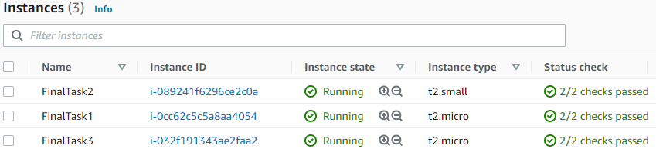
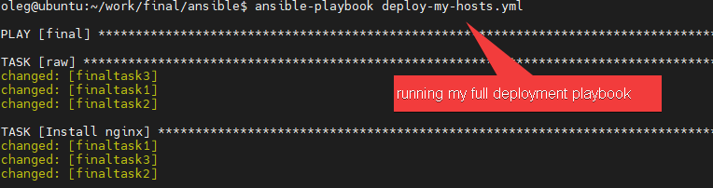
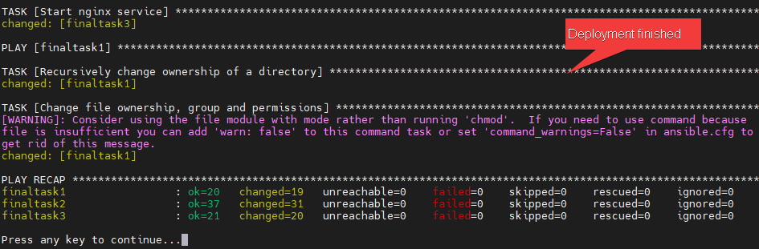

Slide 9
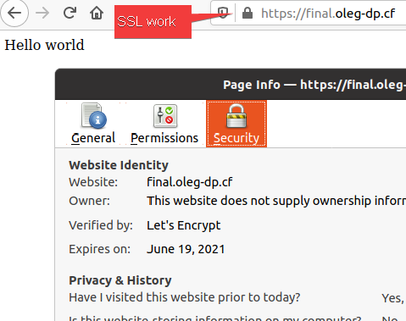
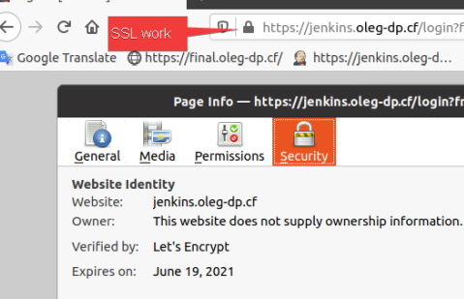
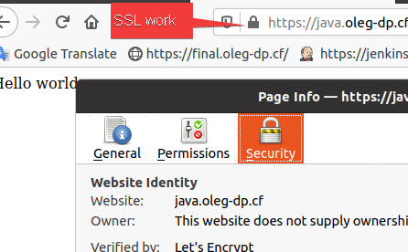
There are we can see how works SSL Certificate on all instances, deployed by ansible

Slide 10
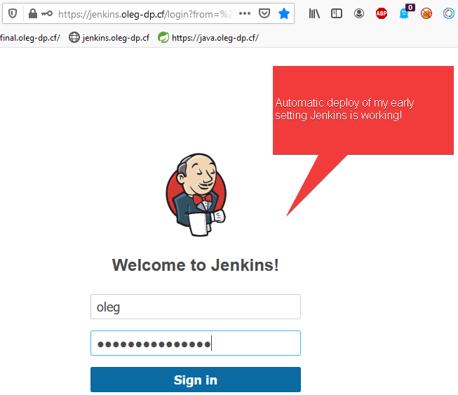
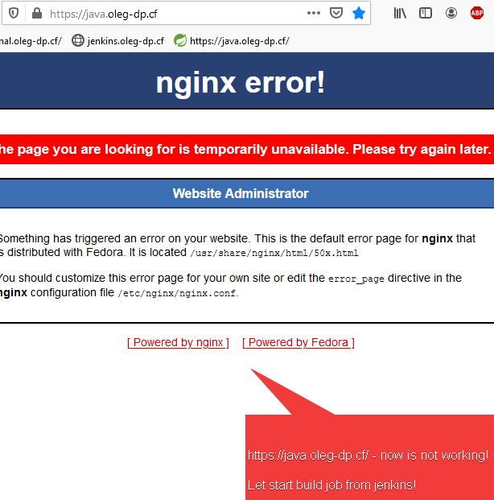
All instances work !

Slide 11
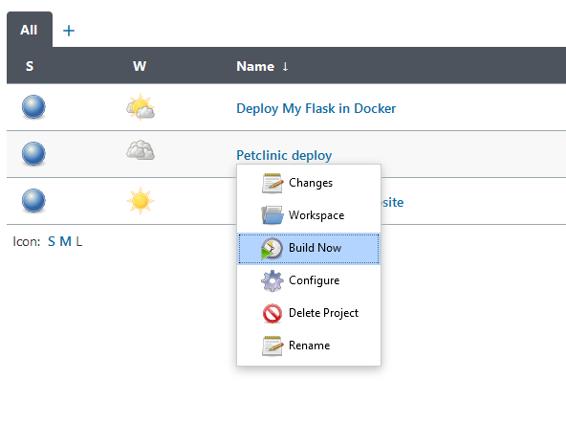
Let's build Java APP (Petclinic)
Job
echo "tar -xvzf ~/petclinic.tar.gz" > start.sh
echo "nohup /usr/bin/java -Dhudson.util.ProcessTree.disable=true -jar ~/target/*.jar > /dev/null 2>&1 &" >> start.sh
echo "sudo systemctl stop nginx || echo "not_started" " >> start.sh
echo "sudo systemctl start nginx" >> start.sh
scp -i ~/.ssh/finaltask3.pem -o "StrictHostKeyChecking no" start.sh spring-petclinic/petclinic.tar.gz centos@java.oleg-dp.cf:~
ssh -i ~/.ssh/finaltask3.pem -o "StrictHostKeyChecking no" centos@java.oleg-dp.cf "/bin/bash ~/start.sh"

Slide 12
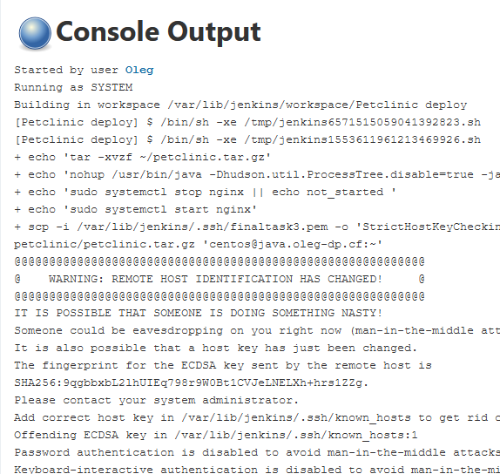
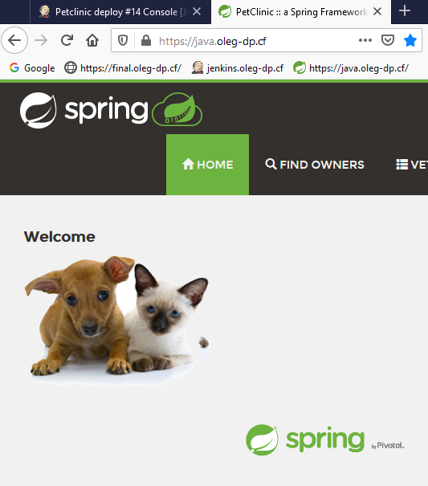
That works!

Slide 13

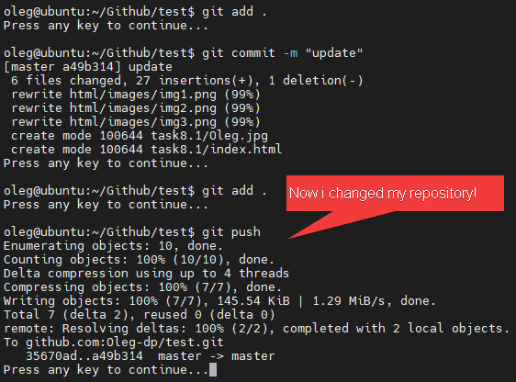
Now we can see how Webhook works
scp -o "StrictHostKeyChecking no" -i ~/.ssh/finaltask3.pem -r html/* centos@final.oleg-dp.cf:/var/www/final.oleg-dp.cf

Slide 14
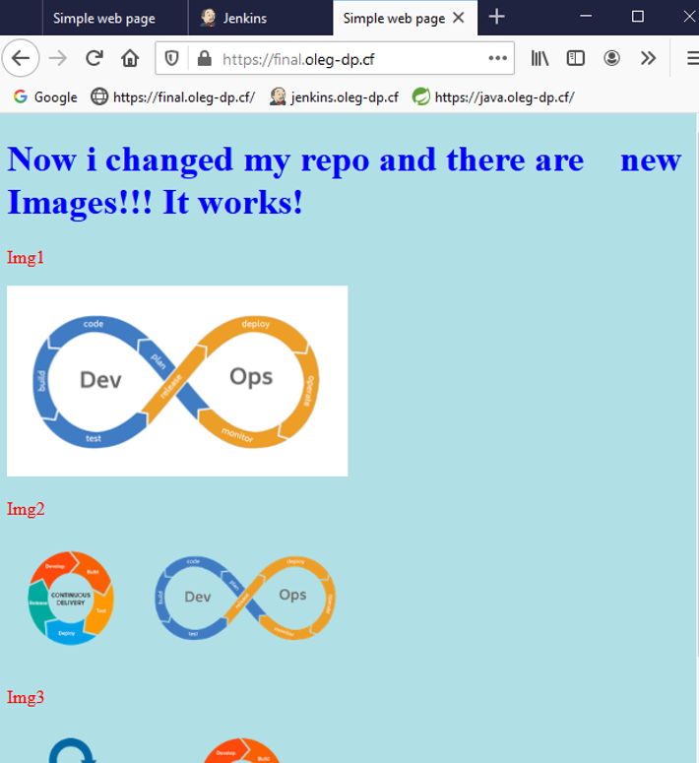
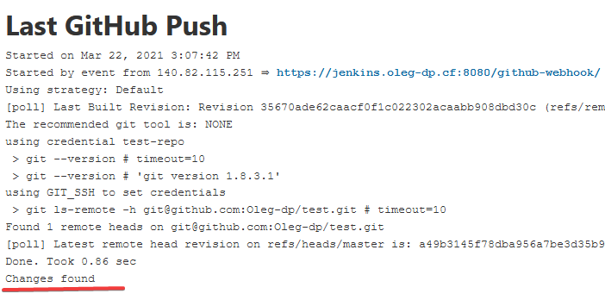
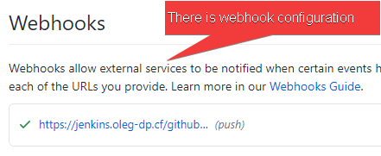
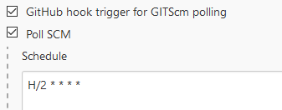
Results of change repository!

Slide 15
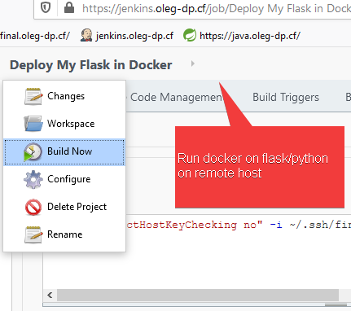
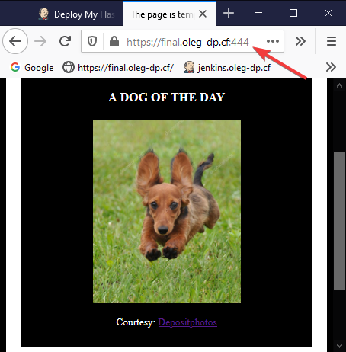
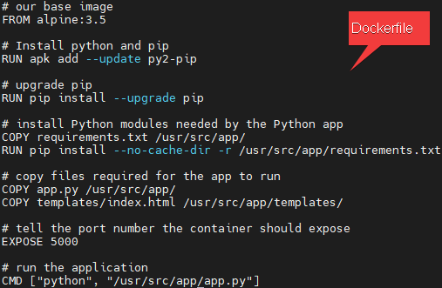
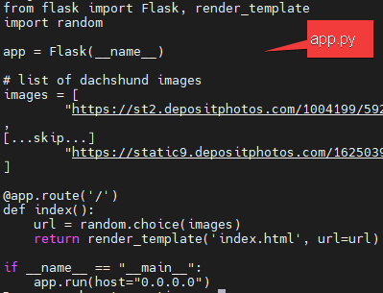
And in the end, I ran early configured Docker Container on the remote host
ssh -o "StrictHostKeyChecking no" -i ~/.ssh/finaltask3.pem centos@final.oleg-dp.cf "nohup docker run -p 5555:5000 \ olegdp/myfirstapp:latest > /dev/null 2>&1 &"

Slide 16
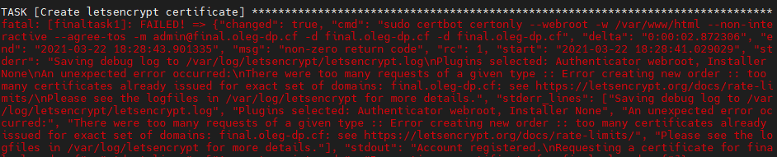
All my code location is: https://github.com/Oleg-dp/DevOps_online_Dnipro_2020Q42021Q1/tree/master/final
Location of my example of repo for webhook in Jenkins, is: https://github.com/Oleg-dp/DevOps_online_Dnipro_2020Q42021Q1/tree/master/final/TEST-REPO
Ironically, just before defend of Final Project, all Let’s Encrypt Certificates informed me: Error creating new order :: too many certificates already issued for exact set of domains
Thus, I was forced to change the FQDN and make sure that my configuration works on the new domain names as well.

Slide 17
Thank you very much!

